Slide 1
VBA Challenge – Homework
Bernardo González Carmona
Data & Analytics BootCamp
Dec 7th, 2019

Slide 2
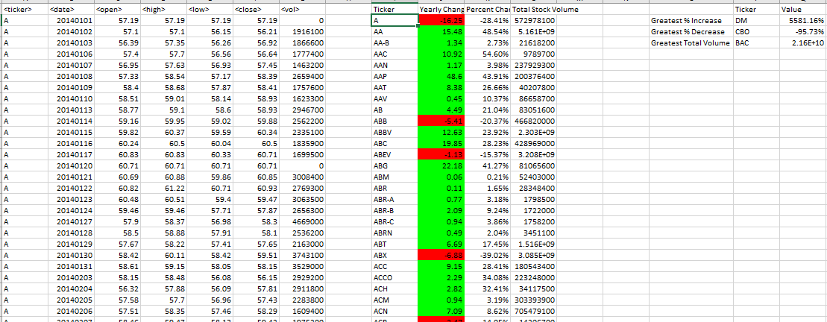
Multiple year stock – year 2014

Slide 3
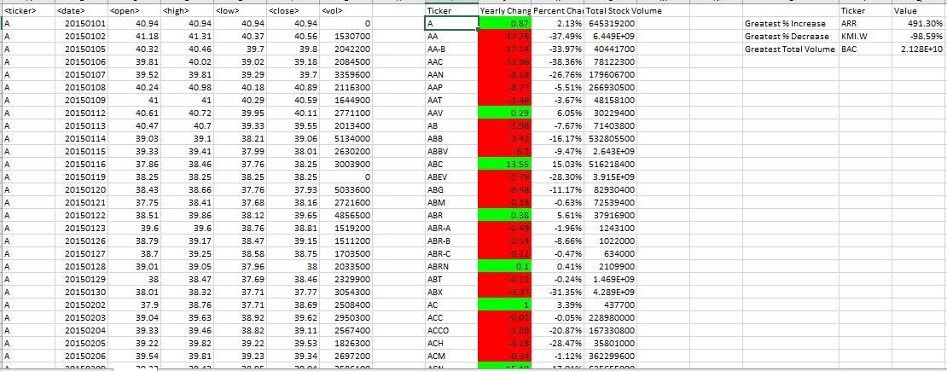
Multiple year stock – year 2015

Slide 4
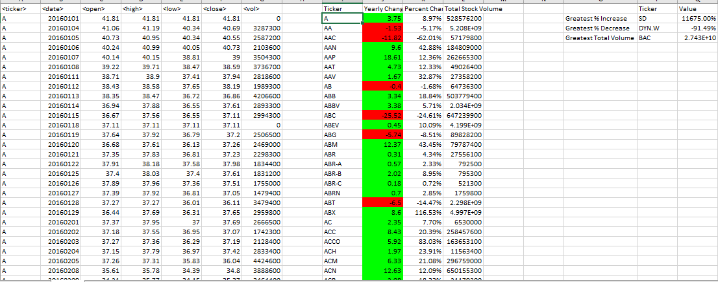
Multiple year stock – year 2016

Slide 5
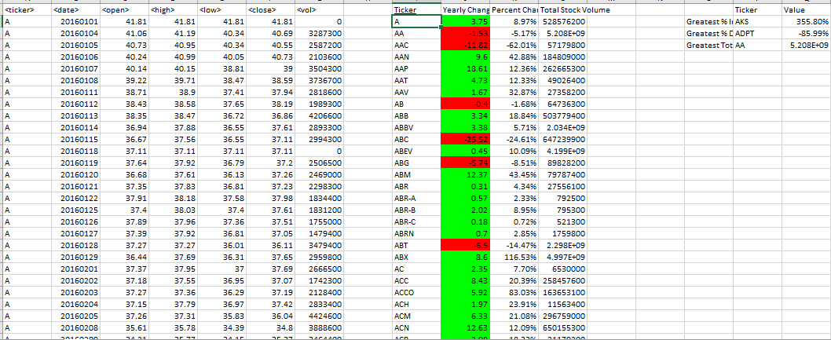
Alphabetical testings - a

Slide 6
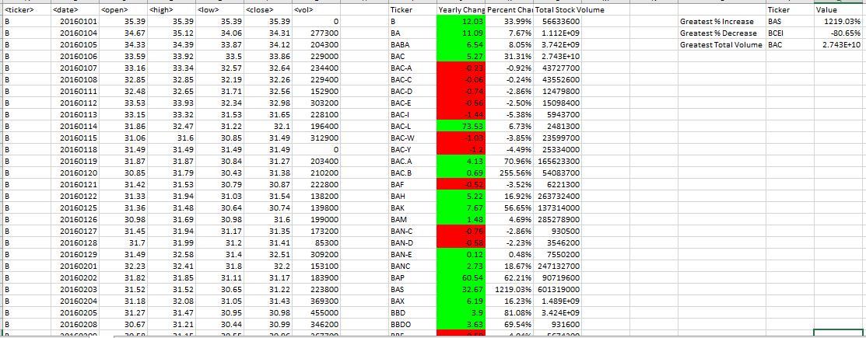
Alphabetical testings - b

Slide 7
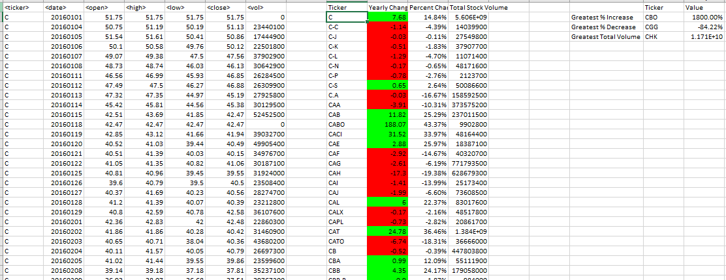
Alphabetical testings - c

Slide 8
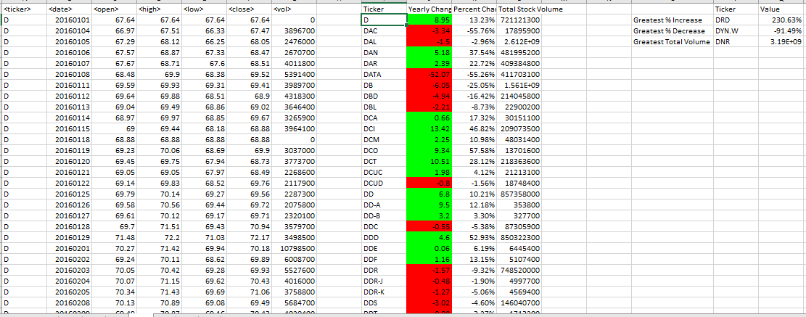
Alphabetical testings - d

Slide 9
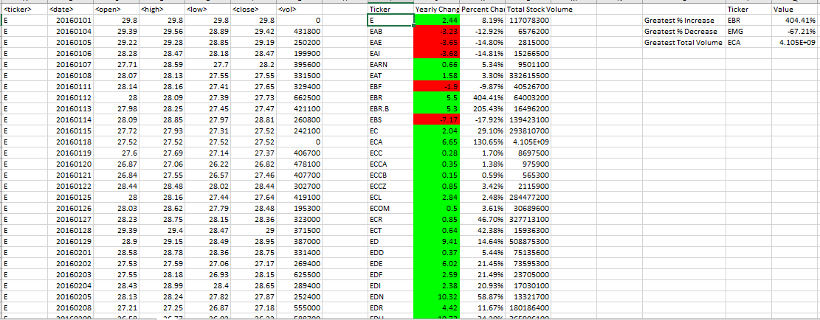
Alphabetical testings - e

Slide 10
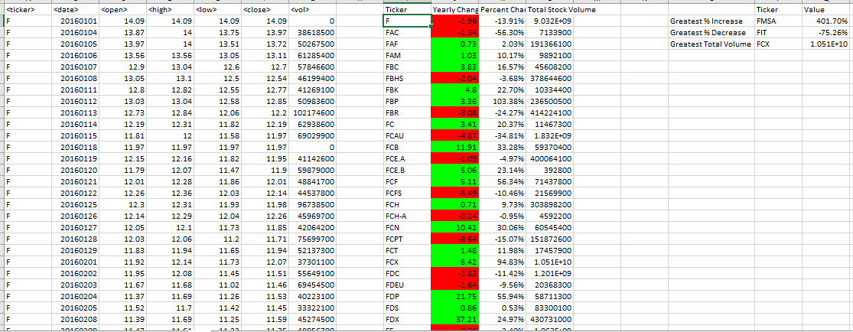
Alphabetical testings - f

Slide 11
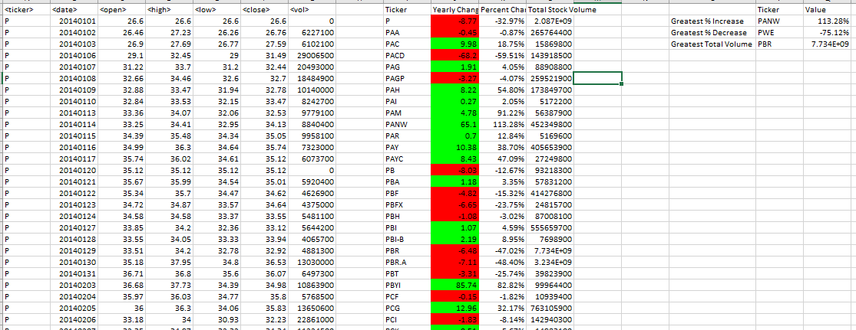
Alphabetical testings - p

